Slide 1

Decision Making Model
Stacey Banks & Desirae Crocker

Slide 2


Problem Statement
A healthcare company’s technology development department is trying to decide which option to go with for storing their software code.
Alternatives:
Stick with GitLab software currently running on self-hosted servers.
Move to GitLab’s cloud software offering.
Leverage Corporate IT’s existing GitHub cloud setup.

Slide 3
Finding a Solution
AHP analysis of alternatives based on important criteria to determine which option is best.
Goal
Functionality
User Rules
Build Types
Security
Security Updates
Support and Maintenance
Implementation Effort
Recurring Costs
Yearly Sub. Cost
Development Workflow Solution
Familiarity
Server Location
Customer Data Management
Vendor Support
Updates
Internal Effort
Internal
Vendor
Support Cost
GitLab Self-Hosted
GitLab Cloud
GitHub Cloud

Slide 4
Key Differences
GitLab Self-Hosted:
Already in place. No effort or cost involved to implement. Users are already familiar with it.
Requires significant ongoing internal support and maintenance. Updates installed internally and infrequently.
GitLab Cloud:
Nearly identical to GitLab Self-Hosted option but with full development workflow solution available.
Low internal support and maintenance required. Would receive more vendor support.
Updates automatically rolled out by vendor.
GitHub Cloud:
Requires effort from multiple internal teams to implement.
Does not have all the required build functionality.
Users are not familiar with the system.
Vendor support not as good as GitLab Cloud.

Slide 5
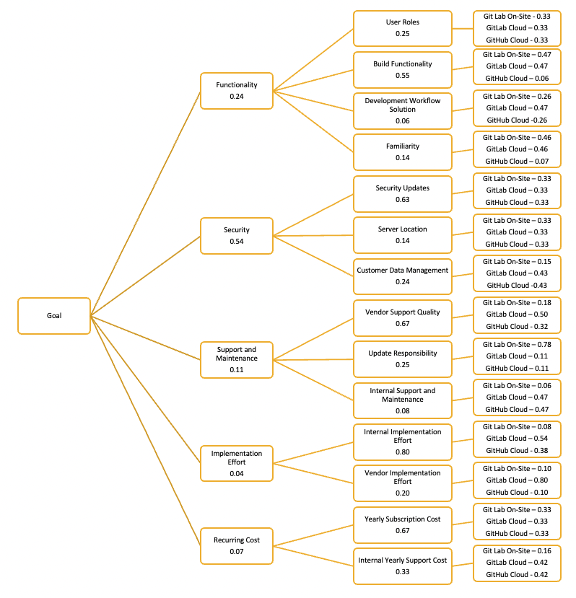
Results from Python
Alternative | Priorities from Python
GitLab Self-Hosted | 0.314858
GitLab Cloud | 0.389721
GitHub Cloud | 0.295421
Final Synthesized Priorities
Super Matrix Data

Slide 6
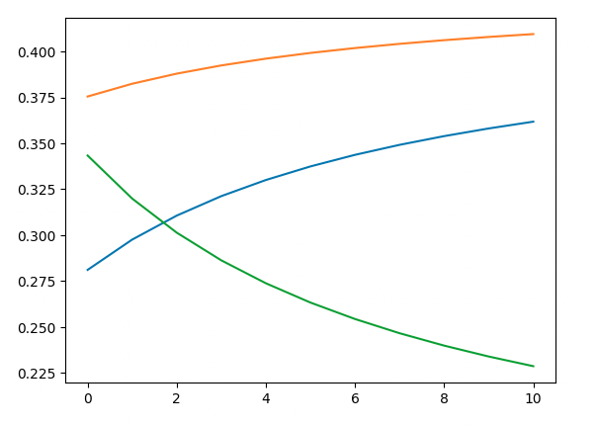
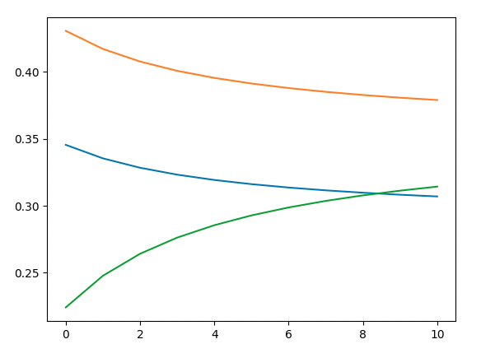
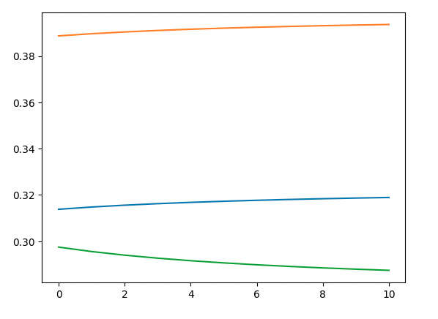
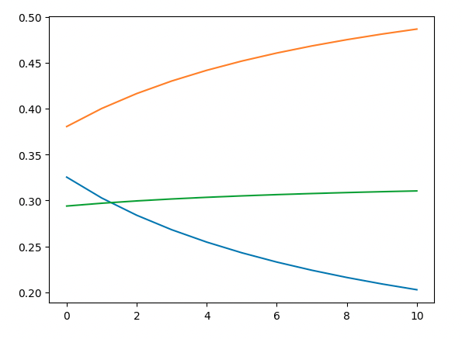
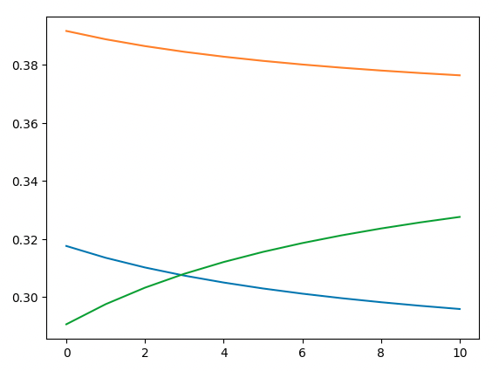
Sensitivity Analysis & Results
LEGEND
GitLab Self-Hosted: -----
GitLab Cloud: -----
GitLab Hub: -----
Functionality
Security
Support and Maintenance
Implementation Effort
Recurring Costs

Slide 7
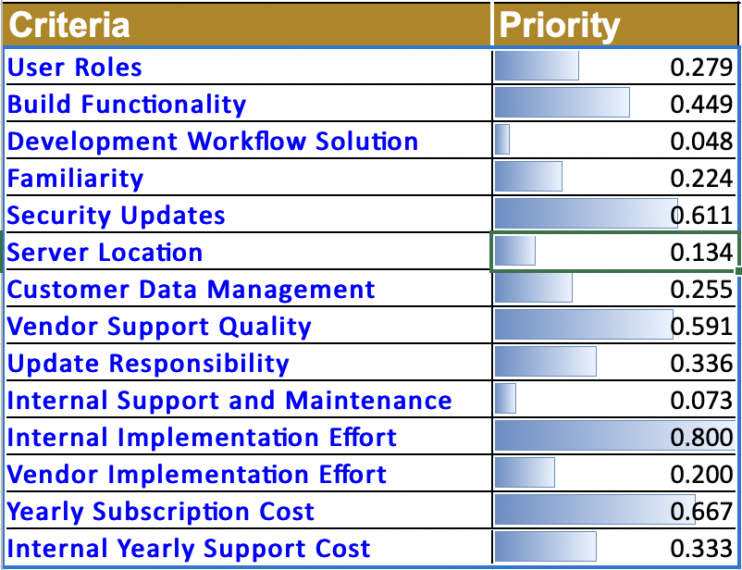
Ratings Analysis
Criteria | Rating Scale
Internal/Vendor Effort | High Medium Low None
Security Updates | Weekly Monthly Quarterly
Vendor Support Quality | Excellent Above Average Average Below Average Poor
Example Rating Scales Used
Final Results
(next slide)

Slide 8
Ratings Analysis Results
Alternative | Priority | Ranking
GitLab Self-Hosted | 0.318 | 2
GitLab Cloud | 0.410 | 1
GitHub Cloud | 0.273 | 3
Ratings analysis results are the same as the results from the Python analysis.

Slide 9
Conclusion
The results were as expected, with GitLab Cloud being the best solution with staying on self-hosted GitLab close behind.
These were the options that were most heavily considered in real life.
The results were closer than might be thought, due to some of the similarities between the offerings.

Slide 10
What Really Happened
A comparison of similar criteria was conducted to identify the best option, which was to migrate to GitLab Cloud by contracting the vendor to perform the migration with internal support.
While Engineering and Security stakeholders were on board, Technology Development Leadership thought the teams could migrate to GitLab Cloud on their own. Once discussions with the vendor began, they learned that there were a lot of "gotchas" that the vendor had tools and processes to handle and that it would be a better idea if they were contracted to perform the migration with the support of the teams for validation since they are familiar with the projects.

